Slide 1
HybridCite: a Hybrid Embedding-IR Citation Recommendation System
A Master‘s Thesis
by
Ashwath Sampath
3 July 2019 Supervisor: Dr. Michael Färber
Examiners: Prof. Dr. Georg Lausen
Dr. Fang Wei-Kleiner

Slide 2
Contents
Introduction
Data sets
Approach and algorithms
Offline evaluation
Online evaluation
Case study
Hybrid23
HybridCite

Slide 3
What do we want to do?
Citation recommendation:
  Process by which scientific papers are recommended as citations for a paper
Local Citation recommendation:
  Get recommendations for a citation context
Investigate & implement different types of approaches, build hybrid model
Create a running local citation recommendation system based on MAG.

Slide 4
Local citation recommendation
Citation context:
Our approach for learning paragraph vectors is inspired by the methods for learning word vectors.
Recommendation task: retrieve k papers for citation context
Title, abstract, authors etc. not used in thesis.

Slide 5
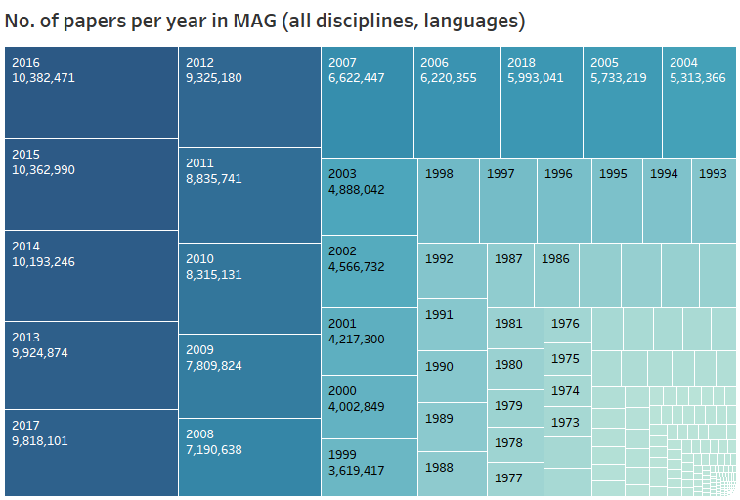
Why is it necessary?

Slide 6
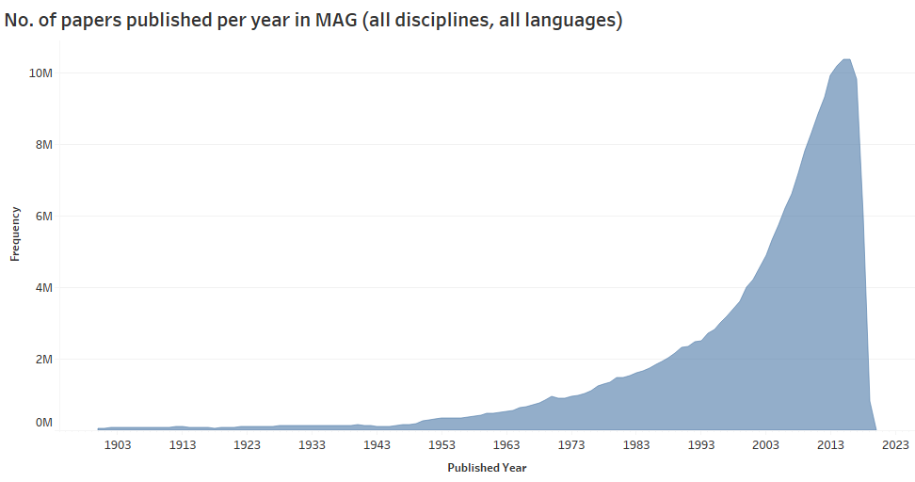
Why is it necessary?

Slide 7
Progress
Introduction
Data sets
Approach and algorithms
Offline evaluation
Online evaluation
Case study
Hybrid23
HybridCite

Slide 8
Data
Age of data:
Better data > more complex algorithms
Special data sets created using:
MAG
Arxiv
ACL Anthology
Unpaywall

Slide 9
Microsoft Academic Graph
Contains:
  many entities: papers, authors, journals, etc.
  Metadata: title, abstract, published date etc.
  citation information
  reference information
  many disciplines
  many languages
  papers from 1800 to present
Does not contain full text.
Full text needed for training algorithms

Slide 10
MAG Pseudo Full-text
No full text, so create ‚pseudo full-text‘
Created for CS, English papers
For each paper in MAG:
  Title, abstract, citation contexts concatenated
  Citation contexts: where paper is citing paper
  Cited MAG IDs added in citation contexts as citation markers.
MAG Training file created with all papers‘ content.

Slide 11
MAG data sets
MAG
  papers with pseudo full-text content
MAG50
  papers with pseudo full-text content
  additional restriction: papers need to have 50 citations
  much fewer papers in training set
MAG-Cited:
  described later

Slide 12
MAG training sets
Data set | #Papers | Years
MAG | 1,620,841 | 1800-2017
MAG50 | 126,666 | 1800-2017
MAG-Cited | 1,629,106 | 1800-2017

Slide 13
Full text data sets
Arxiv, ACL-ARC:
  Restrict to CS, English
  Map all papers to MAG (diff methods)
  Not all cited papers have full text
  Add MAG pseudo full-text for cited papers
Unpaywall:
  Get full text for MAG papers where possible
  Download pdfs, convert to full text (Grobid)
  Pseudo full-text of their cited papers

Slide 14
Full text + pseudo full-text data sets
ACL-MAG, Arxiv-MAG, Unpaywall-MAG
Citation markers = MAG IDs.
Full text + pseudo full-text of cited papers which are not within resp. data set.
E.g. Arxiv: Paper A cites B, C, D, E, F
  B, C are in Arxiv
  D, E, F are not.
  But D, E were mapped to MAG successfully
  Get pseudo full-text from MAG for D, E
  F not in MAG, ignored

Slide 15
Full text + pseudo full-text data sets
Data set | #Papers | #Full-text papers | #Pseudo full-text papers | Years
ACL-MAG | 11,217 | 9,166 (81.72%) | 2,051 (18.28%) | 1965-2005
Arxiv-MAG | 286,272 | 53,614 (18.73%) | 232,658 (81.27%) | 1991-2016
Unpaywall-MAG | 1,185,090 | 397,687 (33.56%) | 787,403 (66.44%) | 1800-2017

Slide 16
Progress
Introduction
Data sets
Approach and algorithms
Offline evaluation
Online evaluation
Case study
Hybrid23
HybridCite

Slide 17
Approaches
Adapt and test multiple algorithms
3 Embedding-based algorithms
Information retrieval: BM25
Topic modelling: LDA
Hybrid model
Combine best-performing algorithms in a hybrid model

Slide 18
Approaches
3 Embedding-based algorithms
  Doc2Vec (Le and Mikolov)
  Paper2Vec (Ganguly et al.)
  Hyperdoc2Vec (Han et al.)
Information retrieval
  BM25
Topic modelling
  LDA (Blei et al.)
Hybrid model

Slide 19
Pre-processing
Make words lower case
Remove stop words based on Stone et al
Expand contractions
Remove punctuations, special characters
Remove white spaces
Surround cited MAG ids by anchor tags (done in data preparation phase)

Slide 20
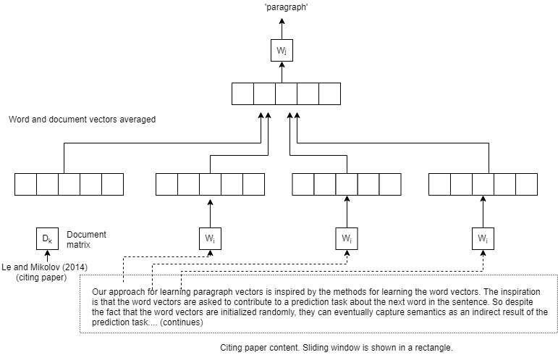
Paper2Vec (1): Doc2Vec (pv-dm)

Slide 21
Paper2Vec (1): Doc2Vec (pv-dm)
Standard neural network with 1 hidden layer
Softmax function in output layer
Paragraph vector (pv): ‚memory‘ of content
Matrix of pvs (D) and wv trained through backpropogation, sliding window used
  Paragraphs & words mapped to unique vectors:
  Each Paragraph: column in D
  Words: column in word vector matrix W
Notes:
In our Paragraph Vector framework (see Figure 2), every paragraph is mapped to a unique vector, represented by a column in matrix D and every word is also mapped to a unique vector, represented by a column in matrix W
Paragraph vectors also address some of the key weaknesses of bag-of-words models. First, they inherit an important property of the word vectors: the semantics of the words. In this space, “powerful” is closer to “strong” than to “Paris.” The second advantage of the paragraph vectors is that they take into consideration the word order, at least in a small context, in the same way that an n-gram model with a large n would do. This is important, because the n-gram model preserves a lot of information of the paragraph, including the word order. That said, our model is perhaps better than a bag-of-n-grams model because a bag of n-grams model would create a very high-dimensional representation that tends to generalize poorly.

Slide 22
Paper2Vec (1): Doc2Vec (pv-dm)
SGD: Words sampled, ‚current‘ word predicted by averaging vectors of surrounding words & the pv in D.
  Maximise log prob of w_{o}|w_{i},D_{k}
  Compute gradient, update params to min. error, slide window.
  Predict new paragraph vectors: SGD with W and softmax weights fixed
Notes:
In our Paragraph Vector framework (see Figure 2), every paragraph is mapped to a unique vector, represented by a column in matrix D and every word is also mapped to a unique vector, represented by a column in matrix W
Paragraph vectors also address some of the key weaknesses of bag-of-words models. First, they inherit an important property of the word vectors: the semantics of the words. In this space, “powerful” is closer to “strong” than to “Paris.” The second advantage of the paragraph vectors is that they take into consideration the word order, at least in a small context, in the same way that an n-gram model with a large n would do. This is important, because the n-gram model preserves a lot of information of the paragraph, including the word order. That said, our model is perhaps better than a bag-of-n-grams model because a bag of n-grams model would create a very high-dimensional representation that tends to generalize poorly.

Slide 23
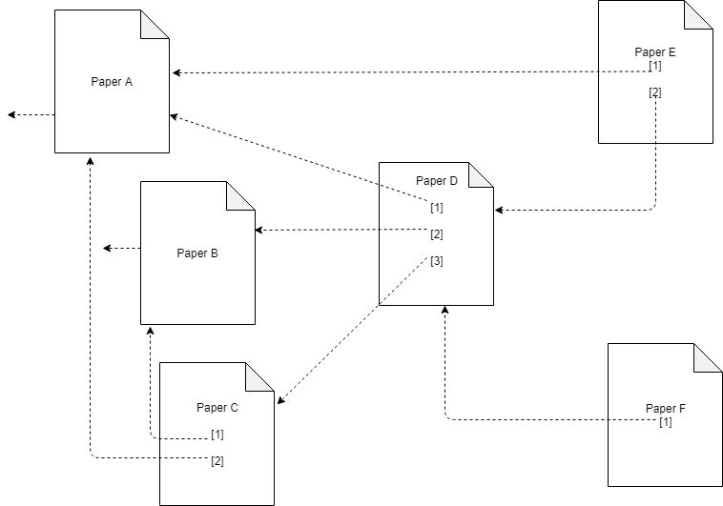
Paper2Vec (2): DeepWalk
Create graph G=<V,E>
  V = papers in data set
  E => edge exists between <citing, cited> pair

Slide 24
Paper2Vec (2): DeepWalk
Random walk through graph
  m times, starting at citing paper
  Length of random walk = n
Create new graph G‘ = <V, E‘>
  New edges: citing paper to papers reached in random walks

Slide 25
Paper2Vec (2): DeepWalk
E.g. Citing paper (node) A in G.
  Outlinks to B and C present: edges A-B and A-C in graph
  Random walks lead to nodes K, L, M
  New edges in graph: A-K, A-L, A-M
  2 edges from A in G, 5 edges in G‘

Slide 26
Paper2Vec (2): DeepWalk
Treat (citing paper, [papers reachable from it in E‘]) as pseudo-sentences.
E.g: [A, B, C, K, L, M]
Init word vecs of all papers from Doc2Vec (Paper2vec Step 1)
Train Word2vec with papers = pseudo words
Predict node from neighbours: CBOW

Slide 27
Prediction Paper2Vec
Get word vectors of words in context
Use multi-class softmax formula
  Get dot product of enriched doc matrix and average of word vectors in context
  Normalise
  Result: probabilities for each paper in corpus
  Sort probabilities, return top k
All word and doc vectors are IN vectors (in Hyperdoc2vec parlance)

Slide 28
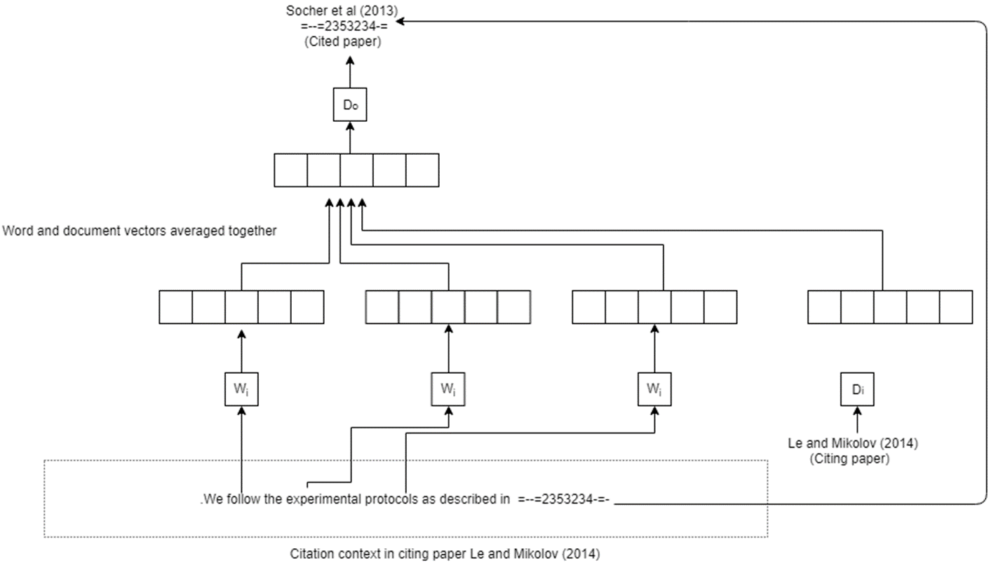
Hyperdoc2Vec

Slide 29
Hyperdoc2vec
Two vectors for each paper P: two roles
IN vectors
  Weights between input and hidden layer
  Represent content of paper: paper as citing doc
OUT vectors
  Weights between hidden and output layer
  Represent contexts in paper: paper as cited doc
Approach: context-aware, content-aware

Slide 30
Hyperdoc2vec
C = (d_{s},c,d_{t}) is a set of citation contexts.
Model contexts‘ impact on embedings:
  Maximise log prob of d_{t}|d_{s},c.
  Average IN word vectors of words in context
  Combine with OUT doc vector in a multi-class softmax classifier
  Slide window, perform next SGD step
Model contents‘ impact on embeddings:
  Word vector predicted from surrounding words and document vector (similar to pv-dm)

Slide 31
Prediction: Hyperdoc2Vec
hd2vINOUT:
  Use both IN and OUT document vectors
  Multi-class softmax formula
  Get IN and OUT word vectors of words in context
  Get dot product of OUT doc matrix and average of IN word vectors of context words
  Get dot product of IN doc matrix and average of OUT word vectors of context words
  Add together resulting vectors and normalise
  Result: probabilities for each paper in corpus
  Sort probabilities, return top k

Slide 32
Prediction: Hyperdoc2Vec
hd2vOUT:
  Use only OUT document vectors
  Multi-class softmax classifier
  Get dot product of OUT doc matrix and average of IN word vectors of context words
  Normalise
  Result: probabilities for each paper in corpus
  Sort probabilities, return top k

Slide 33
LDA
Idea:
  a doc is described by a distribution of topics
  a topic is described by a distribution of words
Train LDA model
  Remove stop words
  Form bi-grams
  Stem words
  Create BOW vectors, dict of word frequencies
  Train using Variational Bayes
  Number of topics = hyperparameter

Slide 34
LDA Prediction
Citation context:
  Remove stop words
  Create bi-grams
  Stem words
  Convert words to BOW vectors
Get topic distribution of BOW vectors
Compare topic distribution of context with topic distributions of training docs
Return top k most similar (cosine) docs
Notes:
def lda_recommend(context_list):
#sleep(0.2)
vec_bow = id2word_dictionary.doc2bow(context_list)
# This line takes a LONG time: it has to map to each of the 300 topics
vec_ldamallet = ldamallet[vec_bow]
# Convert the query to LDA space
sims = malletindex[vec_ldamallet]
sims = sorted(enumerate(sims), key=lambda item: -item[1])[:topn]
# sims is a list of tuples of (docid -- line num in original training file, probability)
return [docid_to_magid.get(docid) for docid, prob in sims]

Slide 35
BM25 Training and Prediction
Training
  Create Solr BM25 index
  Preprocess training text
  Index text
Prediction
  Remove stop words in citation context
  Get top k results from Solr based on BM25

Slide 36
Semi-genetic Hybrid Recommender
Based on paper by Mueller.
Version 1 (version 2 used in final system)
Component algorithms:
  Hyperdoc2vec (hd2vOUT)
  BM25

Slide 37
Semi-genetic Hybrid Recommender
Steps:
  Initialise ‚chromosomes‘ (500 recommendations from each algorithm): 1000 papers
  Calculate fitness scores: weighted reciprocal ranks
  Convert scores to probabilities
  Selection: 1M random samples with replacement
  Count no. of times each paper is drawn
  Sort recommendations by frequency
  Return top k recommendations

Slide 38
Semi-genetic Hybrid Recommender
Example:
  4 papers A, B, C, D (among others)
  A: ranked 10 by BM25, 150 by hd2vOUT
  B: not in top 500 of BM25 , ranked 2 by hd2vOUT
  C: ranked100 by BM25, 20 by hd2vOUT
  D: ranked 50 by BM25, not in top 500 of hd2vOUT

Slide 39
Semi-genetic Hybrid Recommender
Example:
  Step 1: concatenate top 500 recommendations from both algorithms.
  Step 2: Weights = ½ for each algorithm
  Fitness scores for BM25:
    A: 1/10, B: 0, C: 1/100, D: 1/50
  Fitness scores for hd2vOUT:
    A: 1/150, B: 1/2, C: 1/20, D: 0
  Step 3: convert weights to probabilities

Slide 40
Semi-genetic Hybrid Recommender
Example (continued):
  Step 4: 1 million random samples with replacement
    (Other papers not shown)
    A selected 40,000 times
    B selected 56,000 times
    C selected 37,000 times
    D selected 18,000 times
  Step 5: Ranks: B, A, C, D
  Step 6: Return top k most frequently picked items

Slide 41
Progress
Introduction
Data sets
Approach and algorithms
Offline evaluation
Online evaluation
Case study
Hybrid23
HybridCite

Slide 42
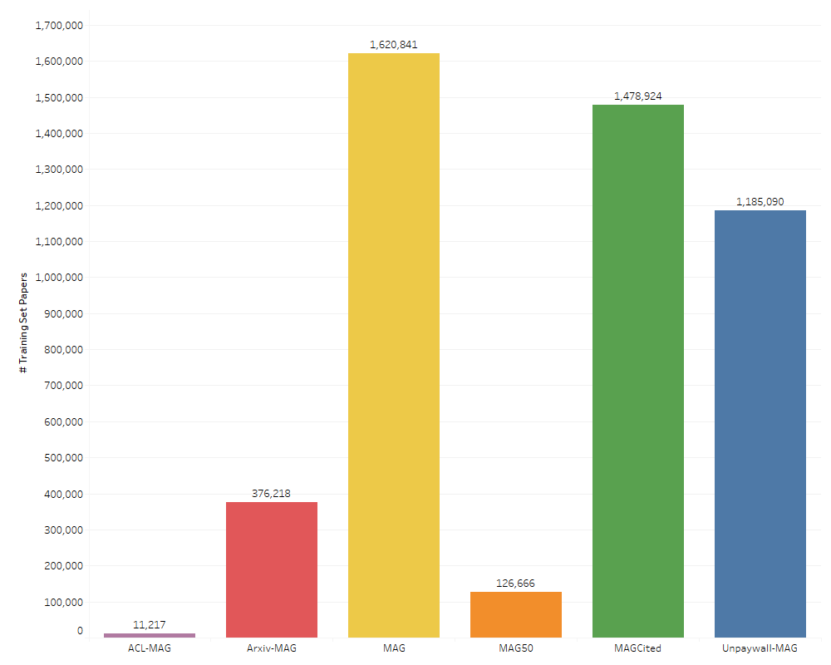
Size of training sets

Slide 43
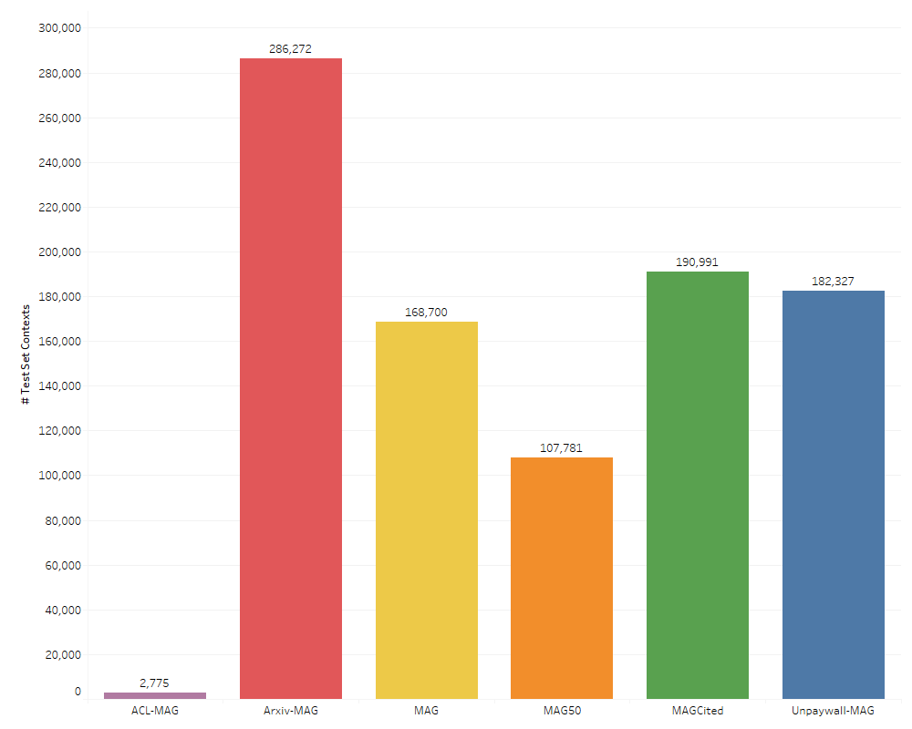
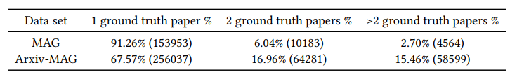
Size of test sets

Slide 44
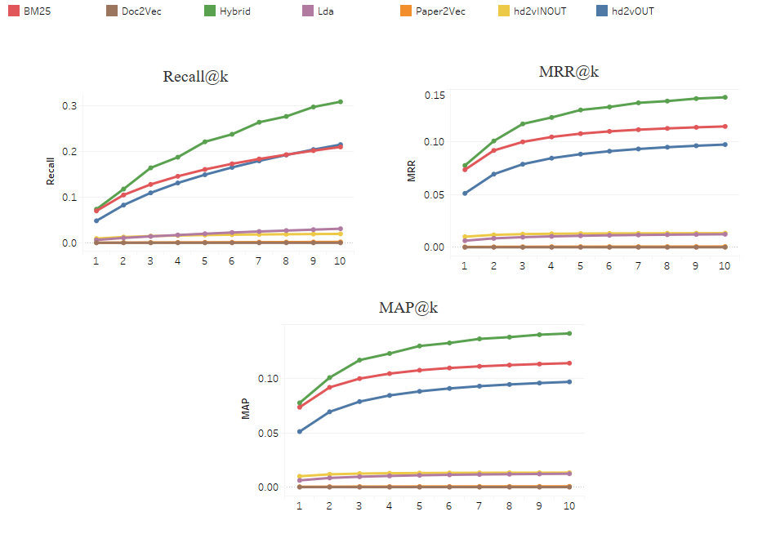
Offline evaluation: MAG
Notes:
Recall curve is steeper because recall is based on the proportion of ground truth items found in the top k. So if the only relevant item is found at pos 4, recall = 1. Curve indicates an average recall over test set contexts. Indicates that more items are found at k = 6, 7, …
MAP and MRR are based on the no. of the k items that are relevant. If an element is found at k=5, MRR@5 = 1/5, MRR@8 = 1/5

Slide 45
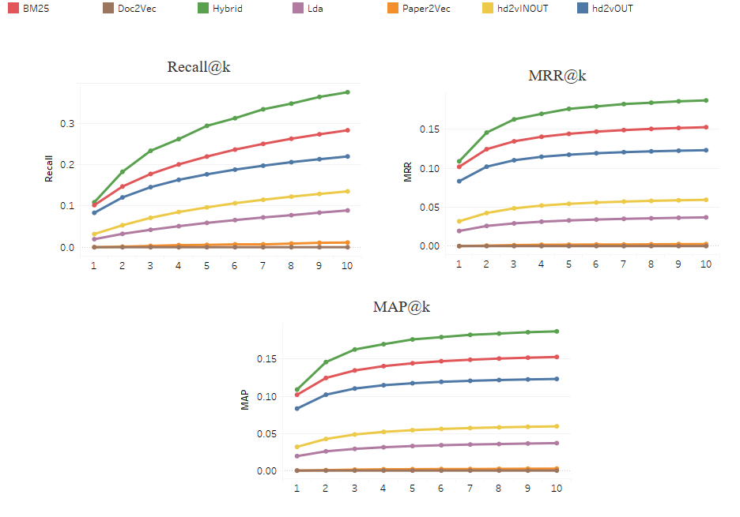
Offline Evaluation: MAG50

Slide 46
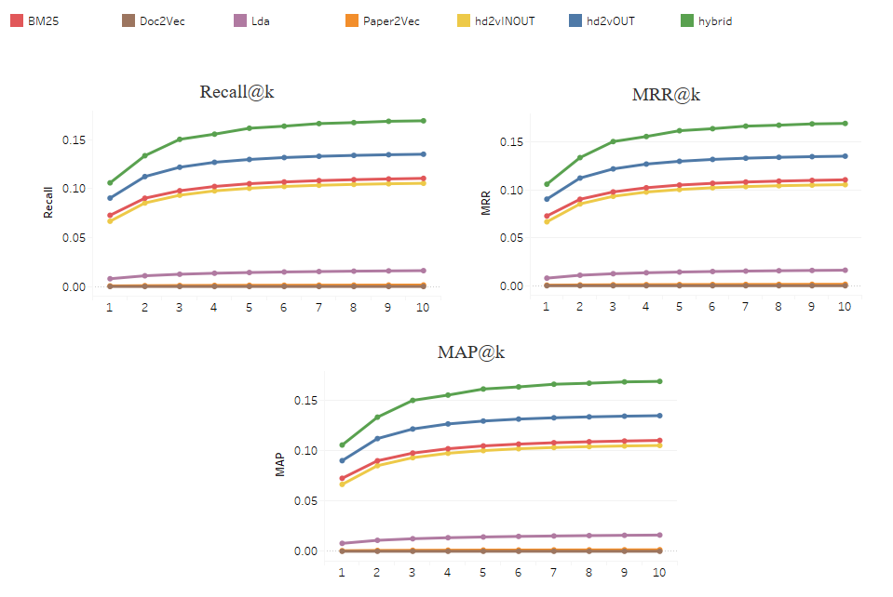
Offline Evaluation: Arxiv-MAG

Slide 47
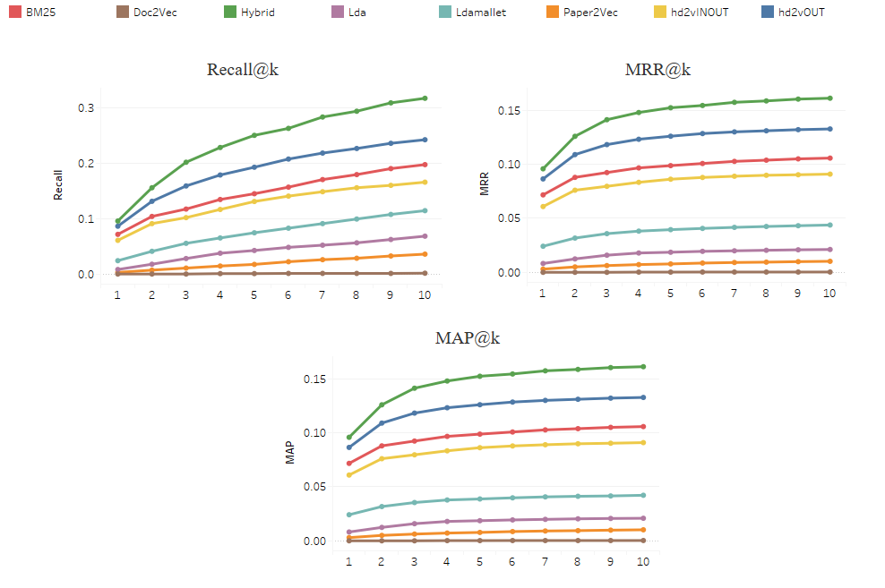
Offline Evaluation: ACL-MAG

Slide 48
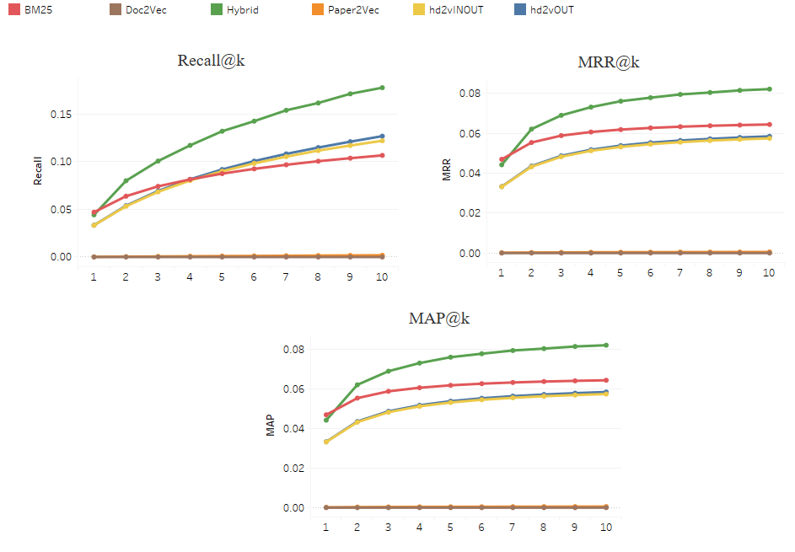
Offline Evaluation: Unpaywall-MAG

Slide 49
Offline Evaluation
Paper2vec and Doc2vec perform badly
Paper2vec better than Doc2vec
LDA below other algorithms
Hd2v works better with OUT vectors only
BM25 and hd2vOUT curves close to each other
hd2vOUT better than BM25 when full text is available
Hybrid works much better than components

Slide 50
Offline Evaluation
MAG50 has higher recall, MAP, MRR than MAG.
BM25 above hd2vOUT for MAG, but below hd2vOUT for Arxiv-MAG, ACL-MAG, Unpaywall-MAG
Recall higher for MAG than Arxiv-MAG because of fewer % of papers with 1 ground truth
Arxiv-MAG metrics better than Unpaywall-MAG

Slide 51
Progress
Introduction
Data sets
Approach and algorithms
Offline evaluation
Online evaluation
Case study
Hybrid23
HybridCite

Slide 52
Online Evaluation
User study:
  Randomly sampled citation contexts from ‚Natural language processing‘ in MAG
  3 models: BM25, hd2vOUT, hybrid
  10 recommendations from each model
  Rated: relevant or not
  Observed that BM25 gets more specific results while hd2vOUT gets more general results

Slide 53
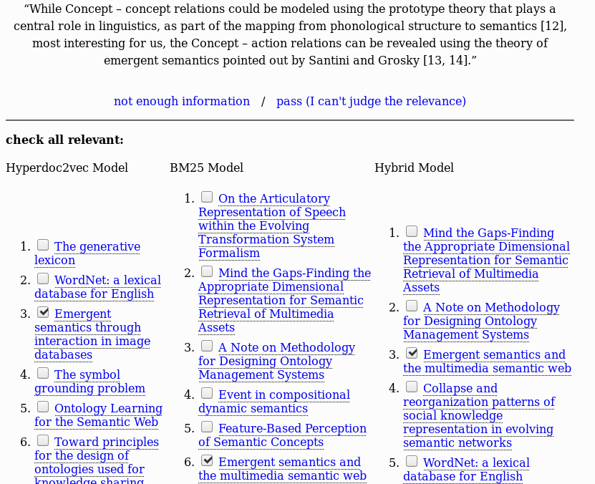
Online Evaluation

Slide 54
Online Evaluation
Caveats:
  small test set
  contexts ambiguous
  recommendations subjective
  Sample may not generalise
Model | MAP@10 | Recall@10 | MRR@10
hd2vOUT | 0.314 | 0.385 | 0.315
BM25 | 0.362 | 0.541 | 0.380
Hybrid | 0.370 | 0.680 | 0.411

Slide 55
Progress
Introduction
Data sets
Approach and algorithms
Offline evaluation
Online evaluation
Case study
Hybrid23
HybridCite

Slide 56
Case study
Observation from Offline evaluation
  OUT vectors work better than IN vectors
  OUT vectors represent role as cited paper
Huang: Citation contexts describe cited papers rather than cititing papers
Case study to prove that citation contexts ‚belong to‘ cited papers
Aim: Create more representative training sets

Slide 57
Case study
Create new data set MAG-Cited (and corr. restricted data set MAG-Cited-50)
Data set contains pseudo full-text, but is different from that of MAG
For each cited paper, get:
  Title, abstract
  all citation contexts in which it is CITED
  Citation contexts are from ITS citing papers
Create training file with all papers‘ content
Populate BM25 Solr index for training data

Slide 58
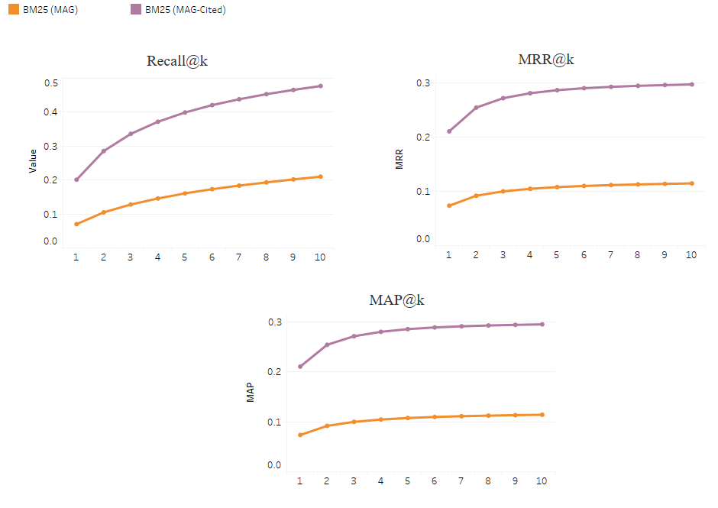
BM25: MAG vs MAG-Cited

Slide 59
Progress
Introduction
Data sets
Approach and algorithms
Offline evaluation
Online evaluation
Case study
Hybrid23
HybridCite

Slide 60
Hybrid23
Semi-genetic hybrid model with 3 components and 2 data sets
Data sets: MAG and MAG-Cited
Components:
  hd2vOUT trained on MAG
  BM25 trained on MAG
  BM25 trained on MAG-Cited

Slide 61
Hybrid23
Same algorithm, steps 1 and 2 change
Step 1:
  Get 500 recommendations each from 3 components
Step 2: Fitness scores:
  Weights:
    hd2vOUT: 1/5
    BM25 MAG: 1/5
    BM25 MAG-Cited: 3/5
  Reciprocal ranks multiplied by weights

Slide 62
Hybrid23
Step 3: Convert scores to probabilities
Step 4: 1 million random samples with replacement
Step 5: Sort by frequency
Step 6: Return top k recommendations

Slide 63
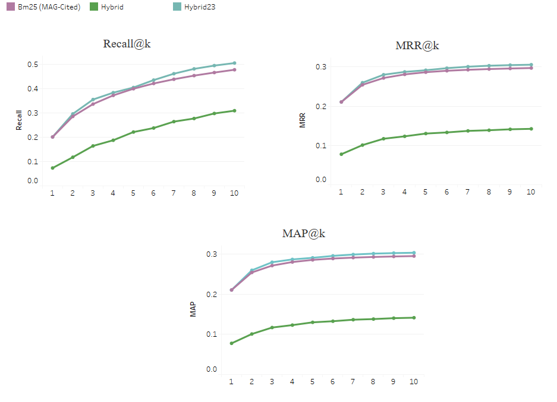
Hybrid23

Slide 64
Progress
Introduction
Data sets
Approach and algorithms
Offline evaluation
Online evaluation
Case study
Hybrid23
HybridCite

Slide 65
HybridCite
Online system running with Hybrid23 under the hood
Type citation context, get recommendations
Choice of 2 models: Hybrid23, Hybrid23-50
Hybrid23-50: no recommendations with <50 citations
Additional option: do not recommend popular papers (>500 citations)
Links to MAG for recommendation
Abstract, published year displayed as tooltip

Slide 66
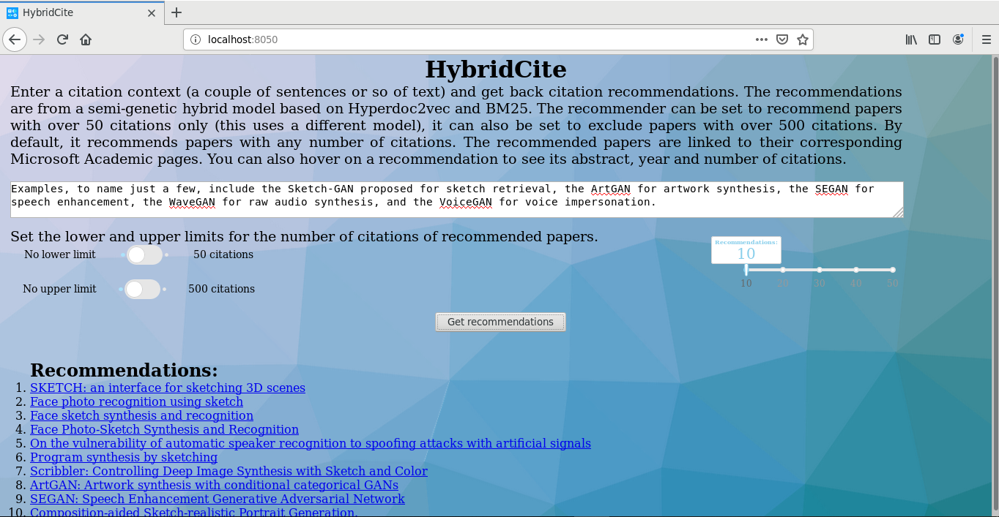
HybridCite

Slide 67
HybridCite Demo
http://132.230.150.16:8050/
Example context:
In this paper, we get word embeddings using FastText, and combine them with Glove vectors to get a complex embedding.

Slide 68
Progress
Introduction
Data sets
Approach and algorithms
Offline evaluation
Online evaluation
Case study
Hybrid23
HybridCite

Slide 69
Conclusion
Citation recommendation is a hard task
OUT embeddings for Hyperdoc2vec were better representations than IN/both.
Citation contexts describe the cited papers more than the citing papers
Hybrid models outperform their components
Using two data sets and three components made a difference in performance

Slide 70
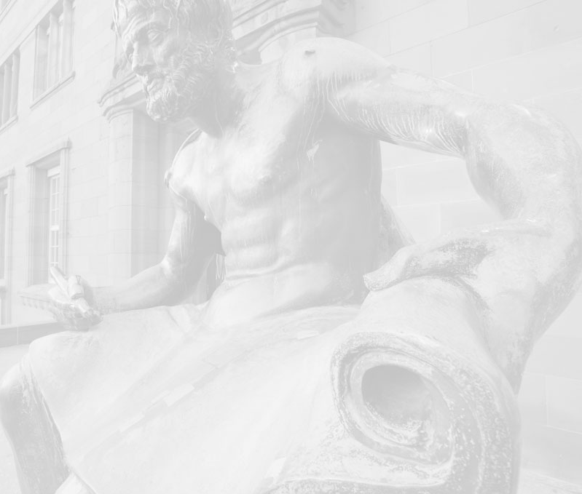
Thank you!

